Slide 1
Python Training
Lesson 00: A basic overview

Slide 2
Table of Contents
Introduction to Python
Variables & Assignments
Basic Data Types
Data Structures
Control Structures
Functions, Modules & Packages
Classes & Objects
Work with Files

Slide 3
Introduction to Python
Features of Python
Installing Python & Online Documentation
Running Python
Using interpreter/cli
Setting up IDE
What is Python
History

Slide 4
What is Python?
Python is a
High level programming language
Interpreted
Interactive
Object Oriented
Python development started in December 1989. Designed by and principal author Guido van Rossum
Influences from other languages
ABC : Core syntax directly inherited
Bourne shell : Interactive Interpreter
Lisp & Haskell : Features such as list comprehensions, map functions
Perl : Regular expressions, shell script
Development Started
3.0
Dec 4, 1989
Dec 3, 2008
1.0
2.0
2.7
3.4
Jan 1, 1994
Oct 16, 2000
Jul 3, 2010
Mar 16, 2014
1989
1989
1992
1995
1998
2001
2004
2007
2010
2013
2014

Slide 5
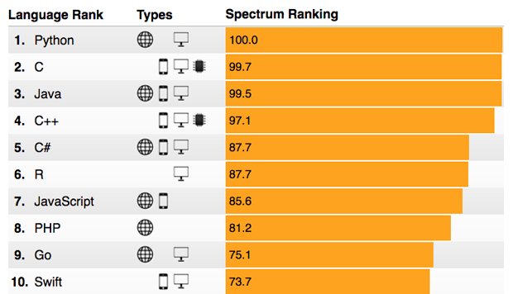
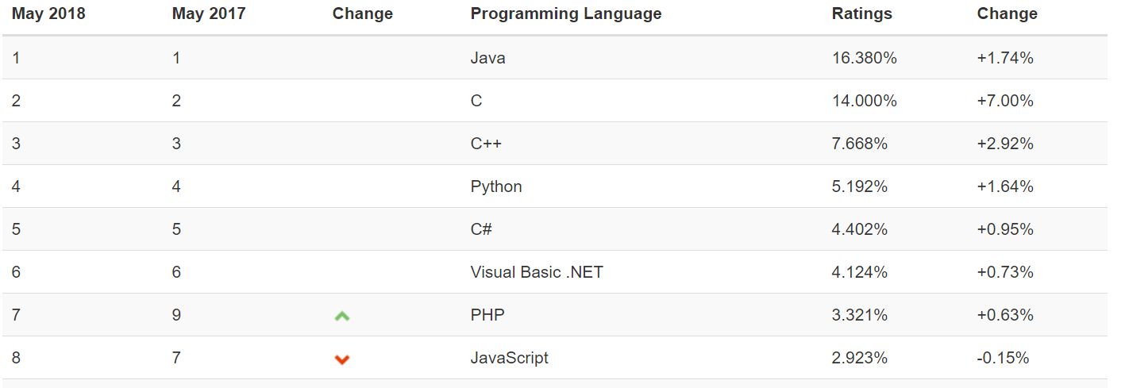
Top programming languages
IEEE Spectrum
TIOBE Index

Slide 6
Features of Python
Feature highlights include:
Easy-to-learn: Python has relatively few keywords, simple structure, and a clearly defined syntax.
Easy-to-read: Python code is clearly defined and if well written visually simple to read and understand.
Easy-to-maintain: Python's success is that its source code is fairly easy-to-maintain.
A broad standard library: One of Python's greatest strengths is the bulk of the library is very portable and cross-platform compatible on UNIX, Windows, and Macintosh.
Interactive Mode: Support for an interactive mode in which you can enter results from a terminal right to the language, allowing interactive testing and debugging of snippets of code.

Slide 7
Features of Python
Feature highlights include:
Portable: Python can run on a wide variety of hardware platforms and has the same interface on all platforms.
Extendable: You can add low-level modules to the Python interpreter. These modules enable programmers to add to or customize their tools to be more efficient.
Database Aware: Python provides interfaces to all major commercial databases.
GUI Programming: Python supports GUI applications that can be created and ported to many system calls, libraries, and windows systems, such as Windows MFC, Macintosh, and the X Window system of Unix.
CGI Programming: Supports server and client side scripting, many libraries and modules
Scalable: Python provides a better structure and support for large programs than shell scripting.

Slide 8
Features of Python
Important structural features that make it an efficient programming tool:
Built-in high level data types: strings, lists, dictionaries, etc.
The usual control structures if, if-else, if-elif-else, while loop, (a very powerful) for loop.
It can be used as a scripting language or can be compiled to byte-code for building large applications. (Using third party tools such as Py2exe or Pyinstaller, Python code can be packaged into standalone executable programs)
Supports automatic garbage collection.
It can be easily integrated with Fortran, C, C++, CORBA, and Java, etc…

Slide 9
Installing Python and documentation
Getting Python:
The most up-to-date and current source code, binaries, documentation, news, etc. is available at the official website of Python: http://www.python.org/
Documentation
You can download the Python documentation from the following site. The documentation is available in HTML, PDF, and PostScript formats: http://docs.python.org/index.html
Tutorial
You should definitely check out the tutorial on the Internet at: http://docs.python.org/tutorial/.

Slide 10
Installing/Running Python IDE
Demo
Notes:
Installation from a shared directory onto the audience systems to be given
If already installation is done then demo of IDE to be done

Slide 11
Language syntax
Structure of python code
Variables & Data Types
Operators

Slide 12
Simple python code
Below is a simple python program on a windows environment.
Quick highlights of syntax
Comments begin with a hash sign (#)
semicolon not mandatory, only to combine multiple statements
Blocks of code called suites are denoted by line indentation (no curly braces!!)
Variables are auto typed, no need to be declared
# This is a comment
x='';
x=input('Enter your name:')
print ('Hello ',x)
x=input('Enter your age:')
y=float(x)
x=int(y)
if x < 0 or x > 150:
print("invalid entry!")
else :
if x > 17 :
print("You are eligible to vote")
else :
print("you are not eligible to vote")

Slide 13
Variables
No need to declare
Need to assign (initialize)
use of uninitialized variable raises exception
Auto typed
if friendly: greeting = "hello world"
else: greeting = 12**2
print greeting
Variable names:
can contain both letters and digits, but they have to begin with a letter or an underscore.
Punctuation characters such as @, $, and % are not allowed.
Are case sensitive.
Cannot be any of the keywords

Slide 14
Reserved words
Python Reserved words: The following list shows the reserved words in Python. These reserved words not to be used as constant or variable or any other identifier names
and | exec | not | as
assert | finally | or | nonlocal
break | for | pass | True
class | from | print | False
continue | global | raise | None
def | if | return
del | import | try
elif | in | while
else | is | with
except | lambda | yield

Slide 15
Basic Data Types
Numbers
Boolean
Operators
Functions
Strings
Operators
Functions
Operators

Slide 16
Numbers
Python supports four different numerical types:
int (signed integers) = C long precision
long (long integers [can also be represented in octal and hexadecimal]) unlimited precision
float (floating point real values) = C double precision
complex (complex numbers) = C double precision
They are immutable data types
Examples:
int | long | float | complex
10 | 51924361L | 0.0 | 3.14j
100 | -0x19323L | 15.20 | 45.j
-786 | 0122L | -21.9 | 9.322e-36j
080 | 0xDEFABCECBDAECBFBAEl | 32.3+e18 | .876j
Notes:
Immutable means that changing the value of a number data type results in a newly allocated object

Slide 17
Numbers: Operators
Arithmetic operators:
Note: No ++ -- operators available
Note that Integer division will produce truncated result
Eg: >>> 1//2 will produce 0
Workaround: 1./2 or float(1)/2
Operator | Description
+ | Addition - Adds values on either side of the operator
- | Subtraction - Subtracts right hand operand from left hand operand
* | Multiplication - Multiplies values on either side of the operator
/ | Division - Divides left hand operand by right hand operand
% | Modulus - Divides left hand operand by right hand operand and returns remainder
** | Exponent - Performs exponential (power) calculation on operators
// | Floor Division - The division of operands where the result is the quotient in which the digits after the decimal point are removed.
Notes:
Immutable means that changing the value of a number data type results in a newly allocated object

Slide 18
Bitwise operators
Bitwise operators
Example: 7<<2, a&b, a|b, 6^8, ~7
Note: These won’t work on float/complex data types
Operator | Description
~ | Bitwise complement, unary operator
& | Bitwise ANDing, binary operator
| | Bitwise Oring, binary operator
^ | Bitwise XORing, binary operator
<< | Left shift, will add trailing zeros
>> | Right shift, will add leading zeros

Slide 19
Numbers: Functions
Internally each of the objects have functions , e.g. as_integer_ratio, numerator, denominator etc
Support available also from “math” module
The math module contains the kinds of mathematical functions you’d typically find on your calculator.
Comes bundled with default installation.
>>> import math
>>> math.pi # Constant pi
3.141592653589793
>>> math.e # Constant natural log base
2.718281828459045
>>> math.sqrt(2.0) # Square root function
1.4142135623730951
>>> math.radians(90) # Convert 90 degrees to radians 1.5707963267948966

Slide 20
Boolean
Python supports bool data type with values True and False
Relational operators applicable as below:
Logical Operators: and , or, not
Operator | Description
== | Checks if the value of two operands are equal or not, if yes then condition becomes true.
!= | Checks if the value of two operands are equal or not, if values are not equal then condition becomes true.
> | Checks if the value of left operand is greater than the value of right operand, if yes then condition becomes true.
< | Checks if the value of left operand is less than the value of right operand, if yes then condition becomes true.
>= | Checks if the value of left operand is greater than or equal to the value of right operand, if yes then condition becomes true.
<= | Checks if the value of left operand is less than or equal to the value of right operand, if yes then condition becomes true.

Slide 21
String
Strings in python are immutable.
You can visualize them as an immutable list of characters.
You can use single quotes, doubles quotes, triple quotes (multiline string) and “r” (raw string)
str1 = “Hello World!”
str2 = “You can’t see me”
Python has many built-in functions to operate on strings.
Usual list operations like +, *, splice, len work similarly on strings.
a =
H | E | L | L | O
0 | 1 | 2 | 3 | 4
-5 | -4 | -3 | -2 | -1

Slide 22
String
Some helpful functions
find() : finds a substring in a string
split() : very useful when parsing logs etc.
format() : A very powerful formatting function that uses a template string containing place holders. Refer documentation for completeness
s2 = "I am {1} and I am {0} years old.".format(10, “Alice”)
The in and not in operators test for membership
>>> "p" in "apple"
True
>>> "i" in "apple"
False
>>> "x" not in "apple"
True

Slide 23
Data Structures
List
Tuple
Set
Data Type Conversion
Dictionary

Slide 24
List
A list is an ordered collection of values.
Similar to arrays in C. One difference between them is that all the items belonging to a list can be of different data type.
a = [] #Empty list
b = [10, 20.1, "ABC"] #List with different data types
nested = ["hello", 2.0, 5, [10, 20]] #Nested List
print b[0]
print nested[3][1]
Accessing elements
>>> numbers[0] #Returns first element
>>> numbers[-1] #Returns last element
>>> numbers[9-8] #Index can be any expression resulting in integer
>>> numbers[1:3] #Slice: returns value at index 1 and 2
>>> numbers[:4] #Slice: returns elements from 0 to 3
>>> numbers[3:] #Slice: returns elements from 3 to last element
>>> numbers[:] #Slice: returns all elements
Lists are mutable: we can change their elements
The function len returns the length of a list, which is equal to the number of its elements

Slide 25
List
The “+” operator concatenates list and “*” operator repeats a list a given number of times.
List Methods: Many in-built methods are available to work on lists.
append, extend, pop, reverse, sort ……
The “pop” method will default pop the last element (LIFO), else can pop by passing the index
Use “del” to delete an element from a list.

Slide 26
Tuple
Tuples are similar to lists, but immutable.
Creating tuples
rec = (“Ricky”, “IKP”, 1234)
point = x, y, z # parentheses optional
empty = () # empty tuple
Tuple assignment: useful to assign multiple variables in one line
x, y, z = point # unpack
(a, b) = (b, a) # swap values
Tuples can be used to return multiple values from a function.

Slide 27
Dictionary
Dictionaries are hash tables or associative arrays.
They map keys, which can be any immutable type, to values, which can be any type.
Example:
>>> eng2sp = {}
>>> eng2sp["one"] = “uno”
>>> eng2sp["two"] = “dos”
>>> print(eng2sp)
{"two": "dos", "one": "uno"}
Dictionaries are designed for very fast access using complex algorithms
Dictionaries are mutable.

Slide 28
Dictionary
As mentioned, the keys can be any immutable type. This allows even a tuple to be a key.
>>> matrix = {(0, 3): 1, (2, 1): 2, (4, 3): 3}
Useful Functions:
dct.keys() #return a list of keys
dct.values() #return a list of values
dct.items() #return a list of key-value pairs
dct.has_key() #check for key existence in dictionary
dct.get(‘key’, 1) #here if ‘key’ does not exist, then 1 will be returned
Since dictionaries are mutable, so be aware of “aliasing”. Use the copy() method to create a copy of original.
Use del to delete elements in dictionary.

Slide 29
Sets
“set” is a container that stores only unique elements.
>>> basket = ['apple', 'orange', 'apple', 'pear', 'orange', 'banana']
>>> fruit = set(basket) # create a set without duplicates
>>> fruit
set(['orange', 'pear', 'apple', 'banana'])
>>> 'orange' in fruit # fast membership testing
True
>>> 'crabgrass' in fruit
False
>>> # Demonstrate set operations on unique letters from two words ...
>>> a = set('abracadabra')
>>> b = set('alacazam')
>>> a # unique letters in a
set(['a', 'r', 'b', 'c', 'd'])
>>> a - b # letters in a but not in b
set(['r', 'd', 'b'])
>>> a | b # letters in either a or b
set(['a', 'c', 'r', 'd', 'b', 'm', 'z', 'l'])
>>> a & b # letters in both a and b
set(['a', 'c'])
>>> a ^ b # letters in a or b but not both
set(['r', 'd', 'b', 'm', 'z', 'l'])

Slide 30
Data Type Conversion
Function | Description
int(x [,base]) | Converts x to an integer. base specifies the base if x is a string.
long(x [,base] ) | Converts x to a long integer. base specifies the base if x is a string.
float(x) | Converts x to a floating-point number.
complex(real [,imag]) | Creates a complex number.
str(x) | Converts object x to a string representation.
repr(x) | Converts object x to an expression string.
eval(str) | Evaluates a string and returns an object.
tuple(s) | Converts s to a tuple.
list(s) | Converts s to a list.
set(s) | Converts s to a set.
dict(d) | Creates a dictionary. d must be a sequence of (key,value) tuples.
frozenset(s) | Converts s to a frozen set.
chr(x) | Converts an integer to a character.
unichr(x) | Converts an integer to a Unicode character.
ord(x) | Converts a single character to its integer value.
hex(x) | Converts an integer to a hexadecimal string.
oct(x) | Converts an integer to an octal string.

Slide 31
Assignment operator
Multiple assignments
a = b = c = 1 | An integer object is created with the value 1, and all three variables are assigned to the same memory location
a, b, c = 1, 2, "john" | two integer objects with values 1 and 2 are assigned to variables a and b, and one string object with the value "john" is assigned to the variable c

Slide 32
Reference Semantics
There is difference in how python does assignment.
Assignment manipulates reference.
x = y #makes x reference the object y references
x = y #does not make a copy of y
Demo

Slide 33
Changing a Shared List
1
2
3
a = [1, 2, 3]
a
a
1
2
3
b = a
b
a
1
2
3
4
a.append(4)
b

Slide 34
Changing an integer
1
a = 1
a
a
1
b = a
b
new int object created
by add operator (1+1)
a
2
a = a+1
old reference deleted
by assignment (a=...)
1
b

Slide 35
Control Structures
if.. elif.. else
Loops

Slide 36
if.. elif.. else..
If… elif… else…
if x < y:
STATEMENTS_A
elif x > y:
STATEMENTS_B
else:
STATEMENTS_C
Ternary operator supported but generally avoided for clarity
i=1 if 10>20 else 2
Single line if statement
if ( var == 100 ) : print "Value of expression is 100“

Slide 37
Loops
while loop | while expression: statement(s)
 | #Else will be executed if expression is false while expression: statement(s) else: statement(s)
for loop | for iterating_var in sequence: statements(s)
 | for iterating_var in sequence: statements(s) else: statement(s)
 | Useful functions for sequencing:
 | range() / xrange() enumerate() zip() | reversed() sorted() dct.iteritems()

Slide 38
Loops…cont.
Control Statement | Description
break | Terminates the loop statement and transfers execution to the statement immediately following the loop.
continue | Causes the loop to skip the remainder of its body and immediately retest its condition prior to reiterating.
pass | The pass statement in Python is used when a statement is required syntactically but you do not want any command or code to execute.

